Slide 1
Module 4: Mentors as Connector
Notes:
INTENTION
To introduce the final content topic of the pre-match mentor training “Mentor as Connector” and connect to content learned in Module 3.
TRAINER INSTRUCTIONS
Have this slide showing while mentors arrive for the training and give them the handouts they will need.
Most likely, they will be returning from a break after having been trained with Module 3 - PYD. If not, you will want to do quick introduction and briefly summarize Module 3 focusing on the Big 3. You will also want to make sure you have copies of the Anthony and James handout since they may not remember to bring this back with them.
KEY CONTENT
Final session of pre-match training series
Will build on Module 3 to discuss how mentors will build developmental assets by acting as a “connector” for your mentee
Something we do naturally - we’ll apply it intentionally to the role of mentor
SUGGESTED SCRIPT: (1 minute)
This is our final session of our pre-match training series. Thank you for your time and commitment to completing this training. In this session, we are going to talk about how you, as a mentor, will also act as a connector for your mentee. It’s a natural complement to, and an extension of, PYD. Being a connector is also probably something you already do today, you just may not have thought about it in terms of mentoring. We’ll define ‘connector’ in just a moment.

Slide 2
You will learn:
What we mean by mentor as a connector.
How being a connector is an integral component of Positive Youth Development or PYD.
How being a connector benefits mentees.
Notes:
INTENTION
To explain the goals of the training session
TRAINER INSTRUCTIONS
Encourage responses and make sure that what we mean by connector is communicated. If the concept of meeting people, visiting places, and having experiences isn’t conveyed, try to capture it before moving on to the next slide.
KEY CONTENT
Ask for their ideas of what being a connector could mean
Being a connector - meeting people, visiting places, having experiences
How being a connector relates to PYD, and how mentee benefits
SUGGESTED SCRIPT: (2 minutes)
What we want you to learn today is:
What we mean by mentor as a connector.
How being a connector is an integral component of Positive Youth Development or PYD.
How being a connector benefits mentees.
Ask: Do you have any ideas about what I might mean by being a connector? (Pause and allow responses from the group)
That’s right – being connected – having connections to people, place, experiences - connects us to a broader context.
We are introducing you to this concept today so you can begin to think about it with respect to your role as a mentor. Once you have had a chance to meet with your mentee and work with your match support, you’ll be better prepared to explore the ways in which you can be a connector.
It also means helping your mentee to identify and expand their circle of support - making deeper and more permanent connections with other adults.

Slide 3
A Connector is….
Someone who connects people with other people, experiences, and organizations.
Mentors identify assets, interests, and aspirations with their mentee and discuss connections that can foster positive development of these areas.
Notes:
INTENTION
Define mentor as connector and relate to the concept of PYD.
TRAINER INSTRUCTIONS
Review the slide content and be prepared to encourage responses before you move to next slide. You are introducing the Mentor as Connector concept that is central to this module.
KEY CONTENT
Someone who connects people with other people, experiences, and organizations
Explore interests and assets and build on them by doing activities where they can meet people, visit places, have new experiences
SUGGESTED SCRIPT: (2 minutes)
I’d like you to do an exercise with me. Take a couple minutes to think about your own experience. We won’t share any personal information as a group, don’t worry. I’d like you to revisit your assets that you wrote down earlier. If you would like to add more, please do. (If Module 3 was not help immediately prior to Module 4, then ask mentors to write down some assets). Pause to allow time for them to do this. Next, write down one or two of your interests. Pause to allow time for them to do this. Finally, write down an aspiration or two that you have. Pause to allow time for them to do this.
Okay? Now look at that list and come up with one goal that you’d like to achieve based on those aspirations. Pause to allow time for them to do this. What connections could help move you toward that goal? When you think about what you’d do to realize these aspirations, what people, places, or experiences would be helpful? For example, if I wanted to pursue an advanced degree, I might talk with my neighbor who has done this. Pause to allow time for them to do this.
Ask: Would anyone like to share an example of one of the connections? Thanks.
So, a “connector” is someone who connects people with other people, experiences, and organizations – as a “Connector” you will work with your mentee to explore their assets, interests, aspirations and to build on them by meeting people, visiting places, having new experiences. Often these activities lead to realizing even more interests and aspirations. What we’re doing by connecting is “pulling out the greatness in them”.

Slide 4
Links to PYD
Connections help Mentees:
Expand their view of the world
Establish the foundations to adapt to factors like parental incarceration
Build a supportive network
Transition to adulthood using positive constructs
Give back by becoming a connector themselves
Notes:
INTENTION
To provide examples of how social connectedness relates to PYD and can result on positive attributes and outcomes for youth.
TRAINER INSTRUCTIONS
Some of the terms on the slide could be daunting. The suggested script works to simplify these concepts but you’ll want to be sensitive to this as you discuss the content. The concepts provided in the boxes are bolded in the script below. You may want to point to each one as you address them.
KEY CONTENT
Connecting people is an organic process that happens all the time
Integral to PYD approach - sense of connection is one of the 5C’s
Intentionally using social connectedness as a positive asset tool
Child of incarcerated parent may be especially limited to positive exposures because they are concerned with basic needs, stigmatized, angry, or depressed
Building and expanding connections with your mentee, you’ll be able to expand both their circle of support and view of the world
SUGGESTED SCRIPT: (3 minutes)
Essentially, connecting people is an organic process that happens all the time. All youth benefit from being connected. We learned about it in Module 3 – having a sense of connection is one of the 5C’s. As an integral component of PYD, we are intentionally using social connectedness as an asset development tool since it doesn’t always happen for this population of youth.
Youth who have an incarcerated parent or guardian are likely more limited to positive exposures because they are concerned with basic needs like housing, care of siblings, monetary restrictions, and so on. Because of their feelings caused by incarceration, they may not be able to muster confidence or energy to explore positive pursuits on their own. They may not readily be able to identify or recognize other adults in their lives that can support them.
Mentors who are able to connect their mentee’s assets and interests to supportive, positive experiences are helping them to expand their view of the world, they are helping them to build a supportive network, and to establish foundations for adapting to challenges like the incarceration of someone important to them. Focusing on assets and development will give them positive constructs that will help them transition to adulthood. A natural part of this process is that they become a connector themselves.

Slide 5
Circles of Support
You
People I know in my community
People who are important to me and care about me
Most important people in my life
Notes:
INTENTION
Introduce the concept of enhancing circle of support with mentees.
TRAINER INSTRUCTIONS
Have handout ready to distribute to mentors.
KEY CONTENT
Complete Handout 4C: Circles of Support activity allows deeper understanding of the concept of social connections.
Reflect all the people that are important in the mentors’ lives, and those that they would want to have in their lives.
Consider how their mentees may have less supports and connections, and how the mentor can help them to develop relationships that will be supportive.
SUGGESTED SCRIPT: (5 minutes)
As we explore this concept of connections, let’s take a few minutes to consider our own supportive networks. Give mentors the Handout 4C: Circles of Support. Note that we won’t be sharing what they write as a group. This activity will provide us with a map of our connections so we can see them more clearly. Please take a minute or two to fill out each of the circles considering the people and relationships in your life that fit into these categories. These can include family members, friends, people you know from church, school, or work. You decide. Fill in as many people as you can think of. Pause so they can complete.
Now that you have filled out the people who you already have in your life, consider who else you would like to include in your circles. Are there community members you don’t know but would like to know? Are there people who you know from the community that you would like to move to “people who are important to me and care about me”? Are there family members that you wish you were closer to? You can use names, or use titles, such as “math teacher”, “pastor”, “Aunt”. Add these names to the circle using a different color pen or by underlining them. Pause so they can complete.
I want to ask you to consider one more thing. As you look at the people you would like to include in your circles, the ones you underlined (or in another color) start thinking about how you might be able to connect to them. Do you see them often? How would you approach them? Are there other people that might help you to move them into your circle? You don’t have to write these down - I just want you to start thinking about the steps you might take to pull them into your circle.
Thanks for taking the time to complete your circle.
Ask: As you look at your circle, how do you think your circle may differ from your mentee’s circle? Pause for responses.
Ask: How could a mentor learn more about their mentee’s circles of support? Pause for responses.
So let’s keep this in mind as we go through a practice activity.

Slide 6
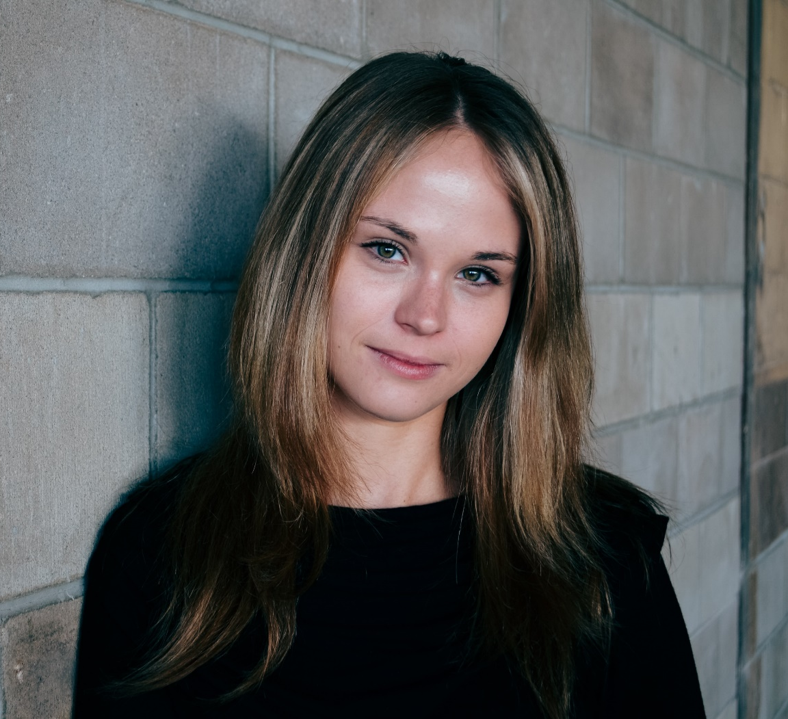
Practice Activity
What assets, interests, and aspirations emerge?
If you were this child’s mentor, what types of people, organizations or experiences would you connect him with? Why?
Notes:
INTENTION
Application of mentor as connector content.
TRAINER INSTRUCTIONS
This is a practice activity for mentors to think about how they might use the mentor as connector content they just learned. Prior to the training, you should have prepared the individual child scenarios provided on the Mentor Training Activity Cards. Ask mentors to gets into small groups (can use same as from earlier in Module 3 or mix it up). Give each group a child to discuss by giving them one of the three child scenarios – Ben, Mary, and Jamal. If you have a large group, simply make sure you have enough cards and understand that some groups might have the same child scenario. If you have a small group, there is no need for all three to be addressed. When you ask them to share their ideas, there is no need to have them read the story.
KEY CONTENT
Practice activity with situations mentor could do to connect their mentee with people, experiences, and places.
Read the scenario, what assets and aspirations emerge for this child?
Discuss what assets and aspirations emerged
If you were that child’s mentor, what people, places, and experiences would build on their assets and aspirations?
Why are connection activities especially important for a youth who has an incarcerated family member?
SUGGESTED SCRIPT: (8 minutes)
Now that we have some ideas of connections, let’s do an activity that explores how assets and interests and what a mentor could do to connect their mentee with people, experiences, and places that related to those. We’re going to get into small groups and I’m going to give you a child scenario. As you read the scenario, what assets and aspirations emerge for this child? If you were that child’s mentor, what people, places, and experiences could you suggest that would build on their assets – what activities could you do? Let’s take about 5 minutes to do this and then we will share some of your thoughts as a full group.
(Allow time mentors to discuss – be on hand in case questions emerge.)
So, let’s hear what came out? We don’t need to read the story – just tell us about the assets, interests, and aspirations you saw in the youth and then what people and experiences did you think could build on these through connections? What activities could you do?

Slide 7
Goal Planning
Big picture conversations about interests and aspirations help to frame ideas about goals for mentoring activities as well as for match support.
What activities would support Anthony in developing his interests and aspirations?
How can match support help Anthony in pursuing these interests and aspirations?
Notes:
INTENTION
Apply the concept of Mentor as Connector to the Anthony and James case study by exploring ideas for goals and activities that relate to assets and aspirations.
TRAINER INSTRUCTIONS
Direct mentors to Anthony and James handout from Module 3.
Facilitate a conversation with mentors that allows them to explore the concept of assets and aspirations and how they can inform ideas for match activities.
KEY CONTENT
Apply Mentor as Connector concepts to the Anthony and James case study
How assets and aspirations inform goal development and ideas for activities that connect
SUGGESTED SCRIPT: (5 minutes)
Lets’ go back to Anthony’s story, who we met in Module 3, this time focusing on the areas that match support and James have identified that can be helpful for Anthony based on conversations they’ve had about interests and aspirations. This frames some ideas about activities for mentoring that foster growth and development – assets - in Anthony.
Toward the end of this story, we consider Anthony’s assets and activities that could foster their development. Let’s take a minute to remember Anthony’s assets and interests. (choreography, music, family, responsible, has future goals, positive values) What are some goals that Anthony might like to focus on based on his interests and aspirations? (Pause to allow mentors to respond) What activities could Anthony and James do? (Pause to allow mentors to respond) In what ways could match support be helpful to Anthony and his family?
Remember that mentors and match support do not make Anthony’s goals for him. Rather, match support guides James in better understanding what options are available and what would be appropriate, as a mentor, to do. It is important that Anthony be included in decisions about activities and that he be supported to create his own goals.

Slide 8
Anthony and James
Family is introduced to services needed for help with child care, transportation, food, and rent assistance.
Anthony is introduced to positive influences that match his assets. Is participating in activities of interest; is meeting people in academics, athletics, arts, career/vocational
Match Support
Anthony and James
Anthony with support from James
Notes:
INTENTION
Apply connector concept to Anthony and James case study
Connect mentee’s interests and assets to ideas for activities
TRAINER INSTRUCTION
Mentors will return to the case study about Anthony and James to apply the concept of “connector”.
You will distribute Handout 4A: Anthony and James Case Study Part 2 as outlined in the suggested script.
KEY CONTENT
Assets, interests, and aspirations should inform ideas for activities the match can do together
Match support can provide additional support to family to address potential barriers
Connections are at the heart of the activities
SUGGESTED SCRIPT (5 minutes)
James and match support have spent time discussing big picture interests and aspirations that he has learned about in his conversations with Anthony. This conversation on interests and aspirations provides ideas for activities that mentor and mentee could do together. They discussed some areas of focus – goals – to support Anthony and the mentoring relationship. Let’s see what they came up with. Match support will reach out to Anthony’s family and suggest some resources. If they are interested, staff will actually connect them to specific place and people to help them feel more comfortable in pursuing them.
Now, consider the goals for Anthony – what are some things Anthony and James could do together to address these goals?
(Pass out Anthony and James Case Study - Part 2) Here’s Part Two of their story Refer to Handout 4A as you review a few of the ideas in each area. As you can see, there are specific activities for match support as well as for James and Anthony to do together but there are also some goals for Anthony to do with encouragement and support from James – high expectation messages.
Let’s look at those activities – there are connections all over the place. What connections do you see being made for Anthony? What people, places, and experiences do you see? Provide an example if struggling (jazz teacher, music store, football half time show, community festivals)
Anthony and James, through match activities that foster Anthony’s areas of interests and aspirations, are building a network of support that will expand his assets. Eventually, as Anthony expands his connections, he develops new skills in developing and navigating relationships. This provides a network of support that acts as a stable foundation for him as he transitions into adulthood.

Slide 9
A Connector is….
Someone who connects people with other people, experiences, and organizations.
Mentors identify assets and interests with their mentee and discuss connections that can foster positive development of the mentee assets.
Notes:
INTENTION
Summarize and close the session.
TRAINER INSTRUCTIONS
This is the same slide that started the training so you will not read the content. It is used to remind mentors of the key content points as you close the session and prepare them for the assessment. Distribute Mentor Handout 4B: Mentor as Connector as you are talking.
KEY CONTENT
As a mentor you will connect your mentee with other people, experiences, and places
Build on assets and aspirations by doing activities where they can meet people, visit places, have new experiences
Mentor as Connector handout captures key points and provides an opportunity to continue brainstorming ideas
SUGGESTED SCRIPT: (2 minutes)
So, a Mentor as “Connector” is someone who connects people with other people, experiences, and organizations. – as a “Connector” you will work with your mentee to explore their interests and assets and to build on them by meeting people, visiting places, having new experiences.
Although it’s a simple concept we still covered a lot of information. Give participants handout 4B. This handout covers some of those key points. On the back is a chart that could start you thinking about some ideas – once you meet your mentee and get to know them, this will be more specific. This training is an introduction to your role as a connector. As you get to know your mentee and work with match support, you will learn more about how you can support your mentee in identifying and expanding his circle of support – making deeper and more permanent connections with other adults and supports. A training will be offered later that builds on these concepts later in your match experience. During the early months, your focus is on getting to know each other. Listening for those assets and interests and sharing some of your own.
As a mentor, your primary goal is to build a strong relationship with your mentee, celebrating their assets, tapping into their interests, and encouraging their aspirations. As you are doing this, you are also in a unique positon to help them identify others that can support them in their growth and development.
You can be that connector.

Slide 10
Wrap Up
Final questions?
Assessment
Thank You!
Notes:
INTENTION
Thank mentors and wish them well
Have mentors complete assessment
TRAINER INSTRUCTIONS
Ask if there are any questions. Hand out assessment and ask them to complete. Thank them for the time they invested and their participation as they complete the assessment and wish them well in their mentoring as you close and dismiss. Add information about any next steps they might need to know if applicable.
KEY CONTENT
Thank them for time and participation
Any additional questions?
Complete assessment
SUGGESTED SCRIPT: (2 minutes)
(As you are passing out Handout 4D: Mentor Assessment)
Before we end, I want to pause and see if you have any questions or comments you’d like to share.
We do have an assessment we need you to complete so we know how effective you think this session was.
I want to thank you again for completing this training series. We hope that with an understanding of these concepts and how they apply to mentoring, that you will feel confident as a mentor. Remember, our staff are here to support you and will be working with you to implement these concepts. We also will provide you additional training and suggestions over the next year, so watch for those opportunities. And remember, you are not alone – you can reach out to your match support at any time.

